Slide 1
Classical
Vs
Quantum

Slide 2
Classical physics – (Pre 1900)
Physics – Newton
Thermodynamics - Boltzmann, Gibbs et al.
Electromagnetics - Maxwell et al.

Slide 3
Classical Physics
The physical universe was deterministic.
Light consisted of waves; ordinary matter was composed of particles.
Physical quantities (energy, momentum, etc.) could be treated as continuous variables.
There exists an objective physical reality independent of any observer.

Slide 4
Failures of Classical Physics
Crucial experimental observations:
Black-body radiation (Planck in 1900)
Heat capacities of solids (Einstein 1905)
Photoelectric effect (Einstein in 1905)
Diffraction of electrons (Davisson and Germer in 1925)

Slide 5
Blackbody Radiation

Slide 6
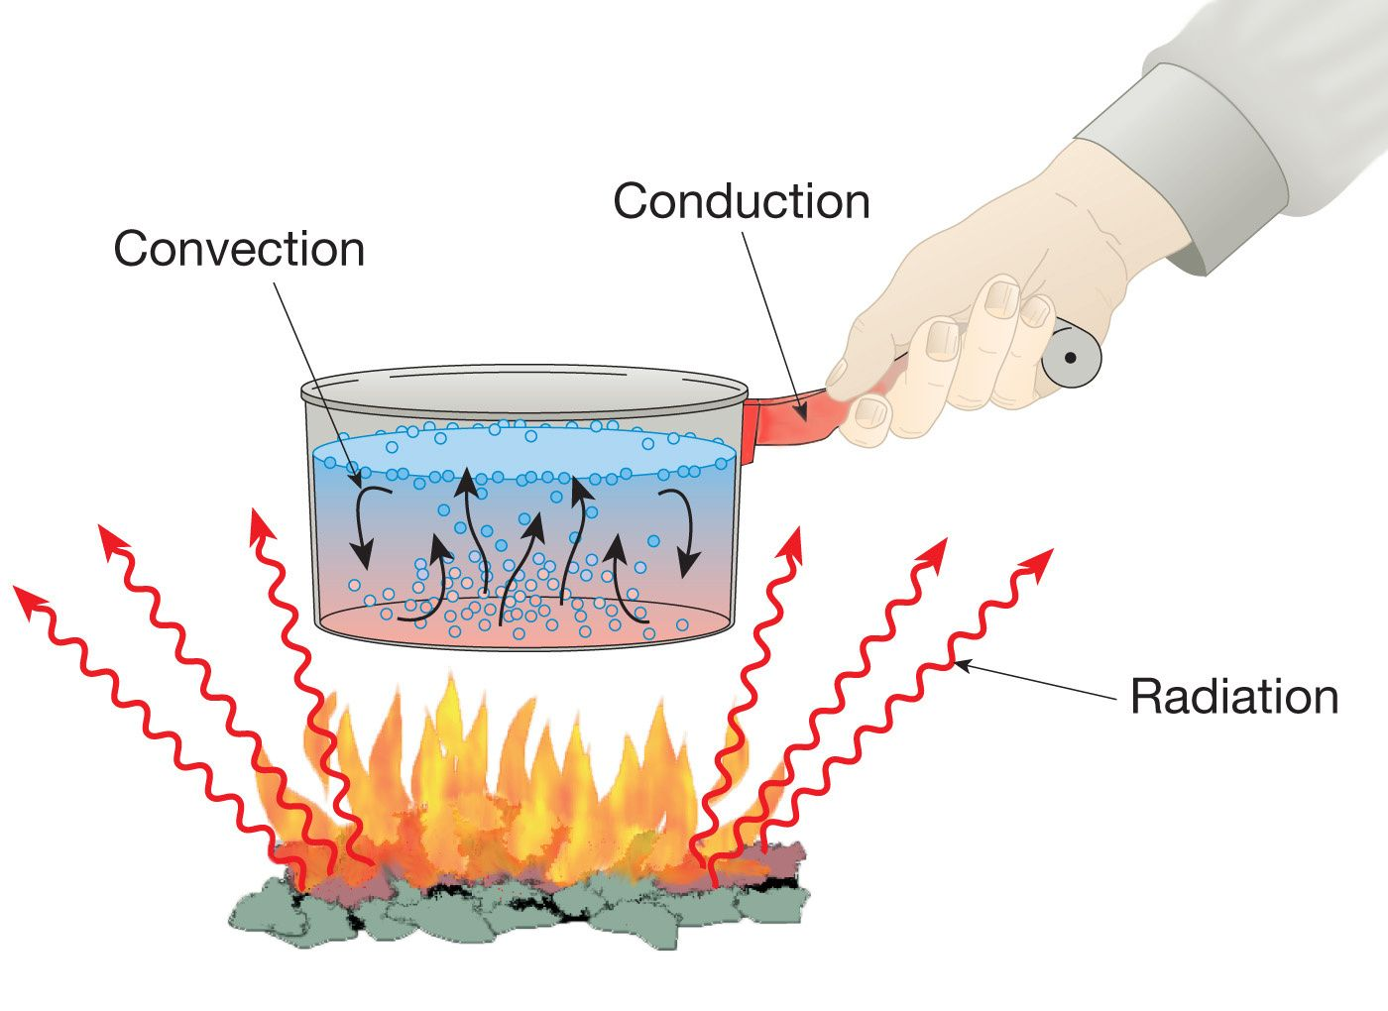
Heat Transfer
It does not require any medium.
This method uses electromagnetic waves which transfer heat from one place to the other.
Ex: Heat & Light from Sun.

Slide 7
If a body is HEATED……???
• It radiates heat, and its color depends on its temperature
• Example: heating elements of a stove:
– Dark red: 550ºC
– Bright red: 700ºC
– Then: orange, yellow and finally white (really hot !)
The emission spectrum depends on the material

Slide 8
Prevost in 1970
Cold body
Receives or absorbs max radiation and emits less radiation
Hot Body
Emits more radiation and absorbs less radiation
All bodies emits radiations at all temperatures .
Whenever the temperature increases emission of energy also increases.
When the temperature of body increases it gives IR, visible, UV .
A body at lower temperatures, gives very a smaller number of radiations.
A body at higher temperatures, it emits IR .

Slide 9
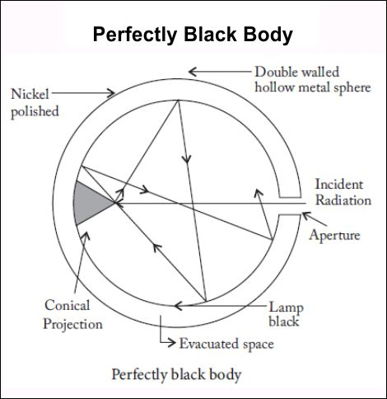
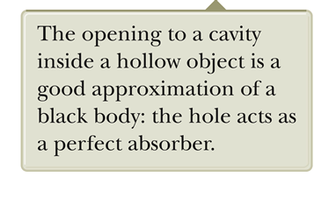
Blackbody
It is perfect ABSORBER & perfect EMITTER.
A good approximation of a black body is a small hole leading to the inside of a hollow object.
The hole acts as a perfect absorber.
The nature of the radiation leaving the cavity through the hole depends only on the temperature of the cavity.
Ex: Lamp Black, Platinum Black
The electromagnetic radiation emitted by a black body is called blackbody radiation.

Slide 10
Characteristics depend on the temperature and surface properties.
The thermal radiation consists of a continuous distribution of wavelengths from all portions of the EM spectrum.
At room temperature, the wavelengths of the thermal radiation are mainly in the infrared region.
As the surface temperature increases, the wavelength changes.
It will glow red and eventually white.

Slide 11
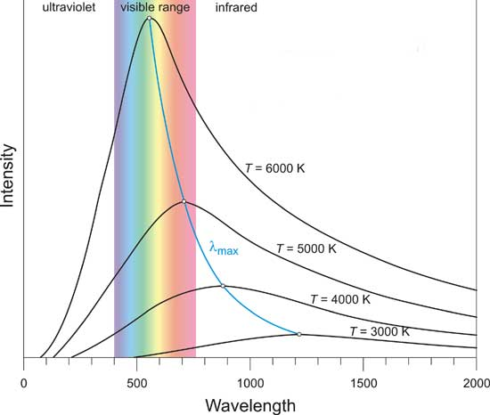
Energy Spectra of Blackbody
The blackbody spectrum depends only on the temperature of the object, and not on what it is made of.
As the temperature of an object increases, it emits more blackbody energy at all wavelengths.
As the temperature of an object increases, the peak wavelength of the blackbody spectrum shifts towards shorter wavelengths.
The blackbody spectrum always becomes small at the left-hand side (the short wavelength, high frequency side).

Slide 12
Laws of Blackbody Radiation
Rayleigh-Jeans Law (Classical Physics)
Stefan-Boltzmann Law
Wein’s displacement law
Planck’s Radiation Law (Quantum Physics)

Slide 13
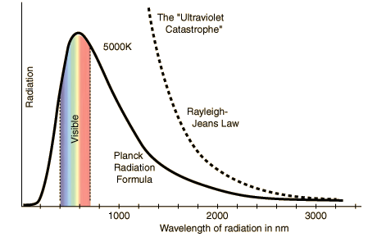
Rayleigh – Jeans law
The energy distributions is directly proportional to the absolute temperature and is inversely proportional to the fourth power of the wavelength
The Rayleigh – Jeans law is quite successful at long wavelengths (low frequencies). It fails badly at short wavelengths (high frequencies).
The failure has become known as the ultraviolet catastrophe.
In classical theory, the energies of the EM waves are continuous.

Slide 14
Stefan-Boltzmann Law
The total amount of radiation emitted by a Blackbody is directly proportional to the Fourth power of its absolute temperature.
The energy radiated by a Blackbody per second per unit area is directly proportional to the Fourth power of its absolute temperature.
Energy = σ T ⁴

Slide 15
Stefan-Boltzmann Law (easy way)
This law links:
the total amount of energy flux that is emitted by a blackbody TO: the body’s temperature
(actually, the 4th power of the body’s absolute temperature)
“the hotter the body, the (much) greater the amount of energy flux or radiation”

Slide 16
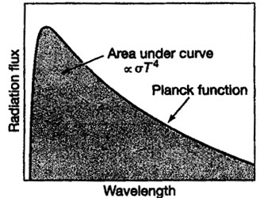
The total amount of energy flux described by the Stefan-Boltzmann Law is proportional to the area under the Planck function curve

Slide 17
Stefan-Boltzmann Law:
“I’m COOL, so I emit LESSER amounts of energy. plus my ENERGY is at a lower intensity than Mr. Hotshot over there!”
“I’m HOT, so I emit LARGE amounts of high intensity energy”
☺

Slide 18
Wien’s Displacement Law
The intensity I is the total power radiated per unit area per unit wavelength at a given temperature.
Wien’s displacement law: The maximum of the distribution shifts to smaller wavelengths as the temperature is increased.
Wavelength decreases as T increases
This law holds good only for shorter wavelengths and not for longer wavelengths.

Slide 19
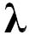
Wien’s Law can be represented as: _{m} = a/T
where λ _{m} is the WAVELENGTH in the spectrum at which the energy peak occurs, (m indicates “max”)
T is the absolute TEMPERATURE of the body, and a is a constant (with a value of 2898) (if λ _{m} is expressed in micrometers.)

Slide 20
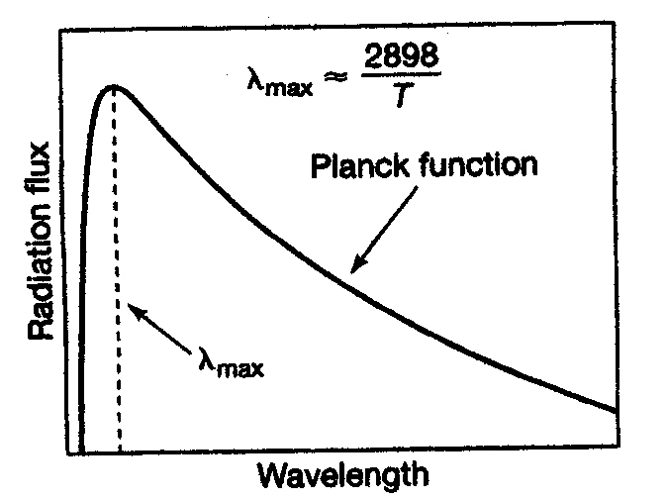
Note the INVERSE relationship between wavelength and temperature

Slide 21
Wien’s Law (easy way)
_{max} = constant / T (Inverse relationship between wavelength and temperature)
“The hotter the body, the shorter the wavelength”
“The cooler the body, the longer the wavelength”

Slide 22
Wein’s Law:
“I’m HOT, so I emit my maximum amount of radiation at SHORTER wavelengths”
“I’m COOL, so I emit my maximum amount of radiation at LONGER wavelengths”

Slide 23
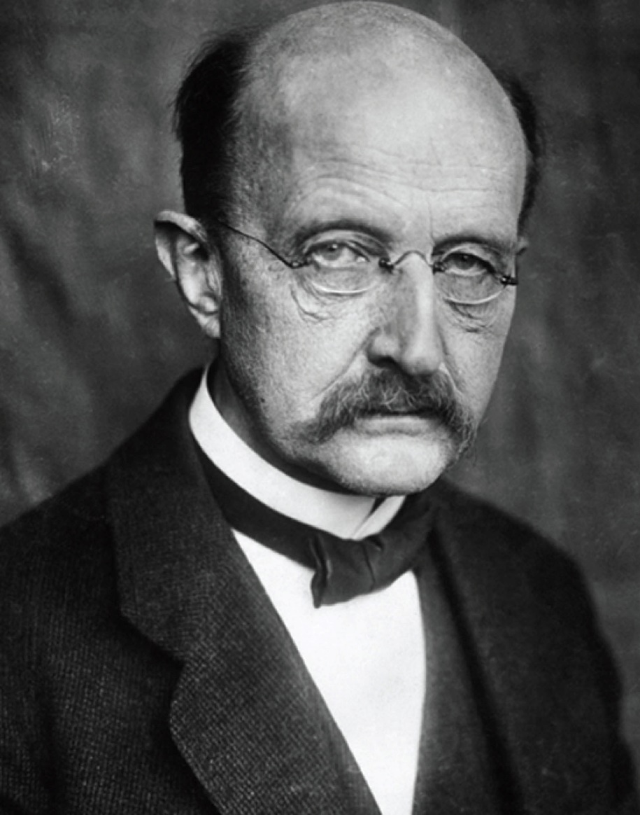
Max Planck
1858 – 1847
German physicist
Introduced the concept of “quantum of action”
In 1918 he was awarded the Nobel Prize for the discovery of the quantized nature of energy.

Slide 24
Planck’s Theory of Blackbody Radiation
In 1900 Planck developed a theory of blackbody radiation that leads to an equation for the intensity of the radiation.
This equation is in complete agreement with experimental observations.
He assumed the cavity radiation came from atomic oscillations in the cavity walls.
Planck made two assumptions about the nature of the oscillators in the cavity walls.

Slide 25
Planck’s Assumption, 1
The energy of an oscillator can have only certain discrete values E_{n.}
E_{n} = n h ƒ
n is a positive integer called the quantum number
ƒ is the frequency of oscillation
h is Planck’s constant
This says the energy is quantized.
Each discrete energy value corresponds to a different quantum state.
Each quantum state is represented by the quantum number, n.

Slide 26
Planck’s Assumption, 2
The oscillators emit or absorb energy when making a transition from one quantum state to another.
The entire energy difference between the initial and final states in the transition is emitted or absorbed as a single quantum of radiation.
An oscillator emits or absorbs energy only when it changes quantum states.
The energy carried by the quantum of radiation is E = h ƒ.

Slide 27
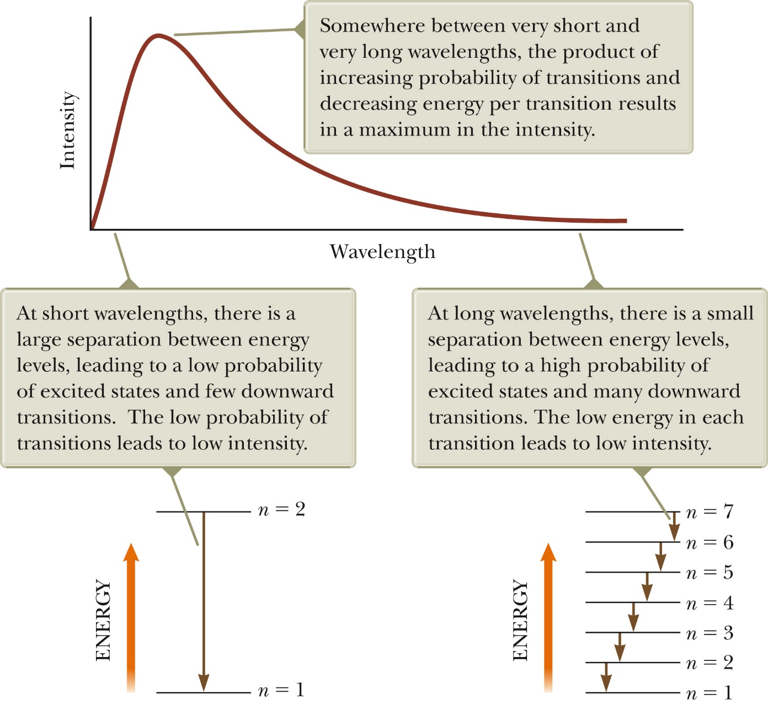
Planck’s Model Graph

Slide 28
Planck generated a theoretical expression for the wavelength distribution.
h = 6.626 x 10⁻³⁴ J.s
h is a fundamental constant of nature.
At long wavelengths, Planck’s equation reduces to the Rayleigh-Jeans expression.
At short wavelengths, it predicts an exponential decrease in intensity with decreasing wavelength.
This is in agreement with experimental results.

Slide 29
Photoelectric Effect

Slide 30
The Photoelectric Effect
“The emission of electrons from a metal surface when illuminated by light or any other radiation of suitable wavelength”
IT WAS FIRST OBSERVED BY HEINRICH HERTZ IN 1887

Slide 31

PHOTONS
METAL
e
ELECTRONS
e
e
e
e

Slide 32
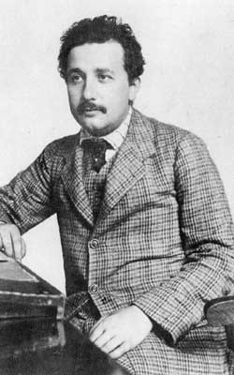
I was only 26
in 1905!!
Albert Einstein explained the photo- electric effect in 1905.
He won the Nobel Prize for his work in 1921.
He also published his special theory of relativity in the same year.
1879-1955

Slide 33
Few Definations
Work Function (φ): Minimum amount of energy needed to eject an electron from an atom in metal.
Threshold Frequency (ƒ₀): Frequency of light that carries photons with the amount of energy equal to the work function of a metal; will eject an electron with zero kinetic energy.
Stopping Potential (V_{s}): Voltage an ejected electron must move through before being stopped.

Slide 34
Photoelectric Effect
Metal Foil

Slide 35
Photoelectric Effect
Metal Foil

Slide 36
Photoelectric Effect

Slide 37
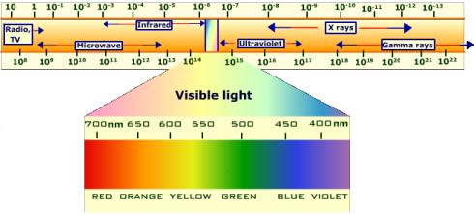
Photoelectric Effect
When red light hits the metal foil, the foil does not emit (give off) electrons.
Blue light has more energy than red light.
How could we get more energy into the red light?
Try increasing the brightness (intensity).

Slide 38
Photoelectric Effect

Slide 39
Photoelectric Effect

Slide 40
Photoelectric Effect

Slide 41
Photoelectric Effect

Slide 42
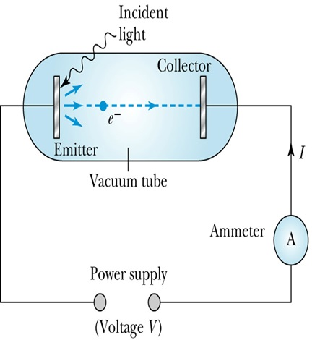
Experimental Setup
The KE of the photoelectrons are independent of the light intensity.
The KE_{max} of the photoelectrons, for a material, depends only on the frequency of the light.
The smaller the work function φ of the material, the smaller is the threshold frequency.
When the photoelectrons are produced, their number is proportional to the intensity of light.
The photoelectrons are emitted instantly following illumination of the photocathode, independent of the intensity of the light.

Slide 43
Results from the Photoelectric Effect
What Scientists predicted | What actually happened?
Increasing the intensity of light would increase the kinetic energy of emitted electrons
Electrons would be emitted regardless of frequency as long as intensity was great enough

Slide 44
Results from the Photoelectric Effect
What Scientists predicted | What actually happened?
Increasing the intensity of light would increase the kinetic energy of emitted electrons | Increasing intensity of light only increased the NUMBER of electrons emitted, not energy
Electrons would be emitted regardless of frequency as long as intensity was great enough | Electrons were emitted even at the lowest intensities, but the light had to be greater than a certain frequency
 | The kinetic energy of the emitted electrons was proportional to the frequency of the incident light

Slide 45
Classical Interpretation
The total amount of energy in a light wave increases as the light intensity increases.
The KE_{max} of the photoelectrons depends on the value of the light frequency f and not on the intensity.
The existence of a threshold frequency is completely inexplicable in classical theory.
For extremely low light intensities, a long time would elapse before any one electron could obtain sufficient energy to escape. We observe, however, that the photoelectrons are ejected almost immediately.

Slide 46
Characteristics of Photo Electrons

Slide 48
Photon
Photoelectron Energy
…and some energy is given to the electron as kinetic energy.
Some energy is needed to release the electron (the work function φ)…
-
Photon Energy = work function + kinetic energy of electron

Slide 49
Factors affecting Photoelectric Effect:
With the help of this apparatus, we will now study the dependence of the photoelectric effect on the following factors.
A potential difference between metal plate and collector.
The intensity of incident radiation.
Frequency of incident radiation.
Nature of the photo metal used

Slide 50
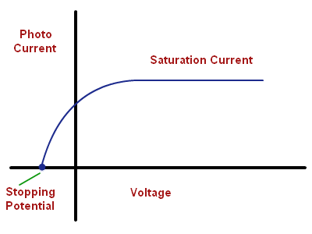
Effect of potential difference :
For a fixed frequency and intensity of incident light, the photoelectric current increases with increase in +ve potential applied to the anode.
When all the photoelectrons reach the plate A, current becomes maximum and is known as saturation current.
When the potential is decreased, the current decreases but does not become zero at zero potential.
This shows that even in the absence of accelerating potential, a few photoelectrons manage to reach the plate on their own due to their K.E.
When –ve potential is applied to the plate A w.r.t. C, photoelectric current becomes zero at a particular value of –ve potential called stopping potential or cut-off potential.
Intensity of incident light does not affect the stopping potential.
At stopping potential the K.E max of electrons is equal to applied potential

Slide 51
Intensity of incident radiation.
For a fixed frequency, the photoelectric current increases linearly with increase in intensity of incident light.
Number of electrons emitted from the metal surface depends up on intensity of incident radiation and stopping potential is independent of incident radiation.
K.E of electrons is independent of incident radiation

Slide 52
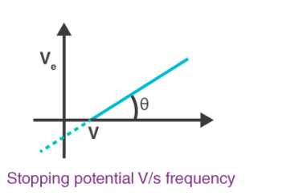
Effect of Frequency of incident radiation.
The graph between stopping potential and frequency does not pass through the origin.
It shows that there is a minimum value of frequency called threshold frequency below which photoelectric emission is not possible however high the intensity of incident light may be.
It depends on the nature of the metal emitting photoelectrons.

Slide 53
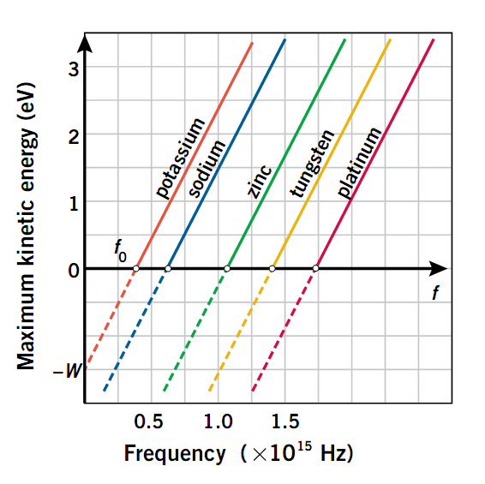
Effect of nature of the photo metal

Slide 54
Laws of Photoelectric Emission
For a given material and a given frequency of incident radiation, the photoelectric current number of photoelectrons ejected per second is directly proportional to the intensity of the incident light.
For a given material and frequency of incident radiation, saturation current is found to be proportional to the intensity of incident radiation, whereas the stopping potential is independent of its intensity.
For a given material, there exists a certain minimum frequency of the incident radiation below which no emissions of photoelectrons takes place. This frequency is called threshold frequency.

Slide 55
Laws of Photoelectric Emission
Above the threshold frequency, the maximum kinetic energy of the emitted photoelectron or equivalent stopping potential is independent of intensity of incident light but depends only upon the frequency (or wavelength) of the incident light.
The photoelectric emission is an instantaneous process. The time lag between the incidence of radiations and emission of photoelectron is very small, less than even 10^{–9}.

Slide 56
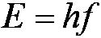
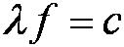
Einstein’s Theory
Einstein suggested that the electromagnetic radiation field is quantized into particles called photons. Each photon has the energy quantum:
where f is the frequency of the light and h is Planck’s constant.
The photon travels at the speed of light in a vacuum, and its wavelength is given by

Slide 57
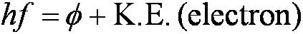
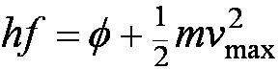
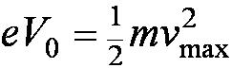
Einstein’s Theory
Conservation of energy yields:
where is the work function of the metal.
Explicitly the energy is
The retarding potentials measured in the photoelectric effect are the opposing potentials needed to stop the most energetic electrons.

Slide 58
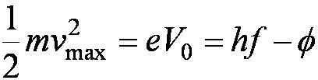
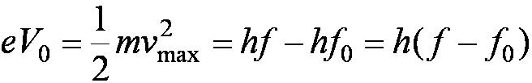
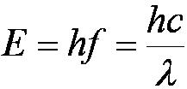
Quantum Interpretation
The kinetic energy of the electron does not depend on the light intensity at all, but only on the light frequency and the work function of the material.
Einstein in 1905 predicted that the stopping potential was linearly proportional to the light frequency, with a slope h, the same constant found by Planck.
From this, Einstein concluded that light is a particle with energy:

Slide 59
Compton Effect

Slide 60
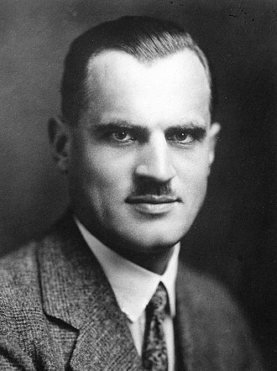
Compton Effect direct proof that PHOTONS are particle in nature.
Noble Prize in 1927.
When light encounters charged particles, the particles will interact with the light and cause some of the light to be scattered.
In 1923, Arthur H. Compton illuminated graphite (a form of carbon) with X-rays
Arthur Holly Compton

Slide 61
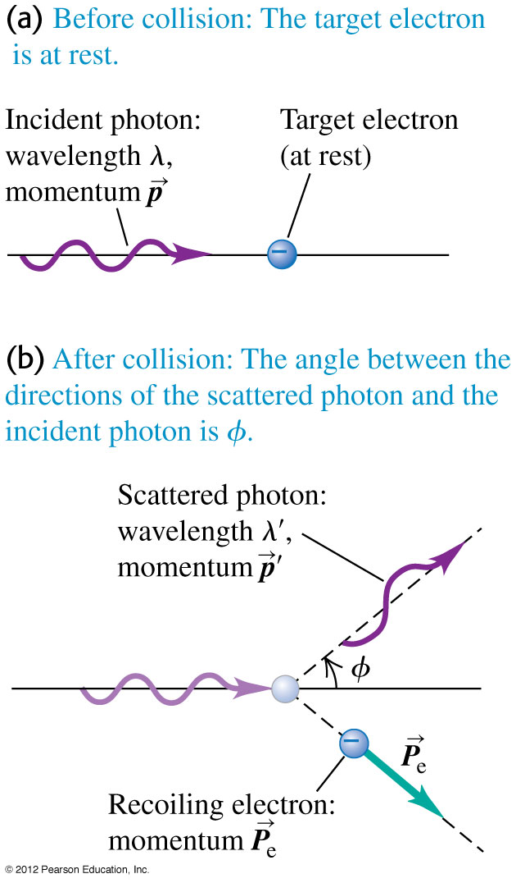
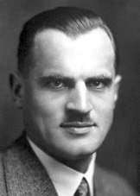
Compton Scattering
Question: Why was the discovery of Compton scattering so important ?
The 1927 Nobel Prize in Physics was divided equally between Arthur Holly Compton "for his discovery of the effect named after him" and Charles Thomson Rees Wilson "for his method of making the paths of electrically charged particles visible by condensation of vapor".
Ans: In a classical (non-QM) physics picture: light is a wave and the final energy will be the same as the initial. Compton scattering is possible if light is composed of photons (a.k.a quanta).

Slide 62
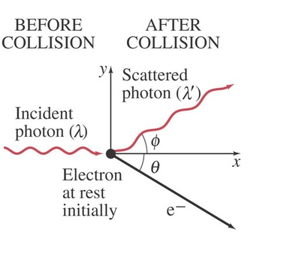
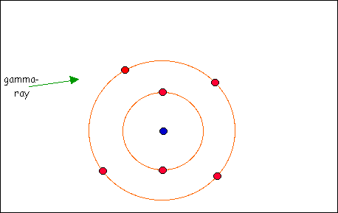

Slide 63
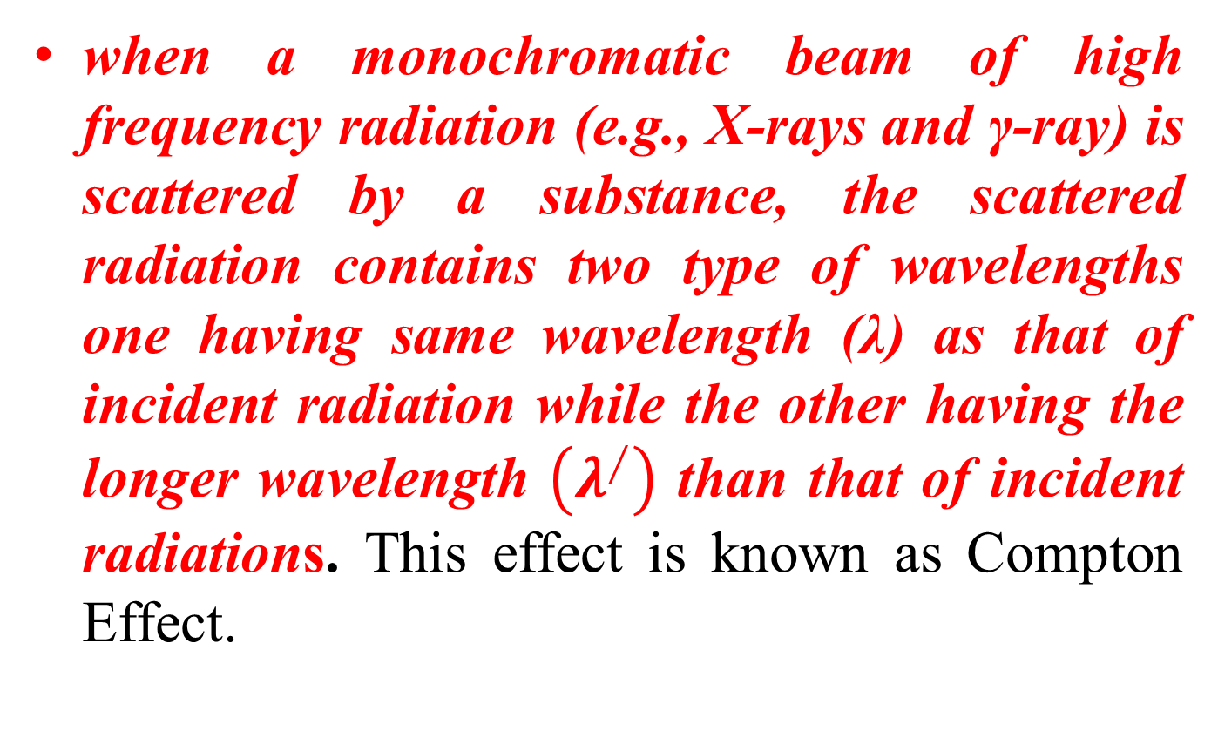
Compton observed that …….
when a monochromatic beam of high frequency radiation (e.g., X-rays and γ-ray) is scattered by a substance, the scattered radiation contains two type of wavelengths one having same wavelength (λ) as that of incident radiation while the other having the longer wavelength $\left(λ^{∕}\right)$ than that of incident radiations. This effect is known as Compton Effect.

Slide 64
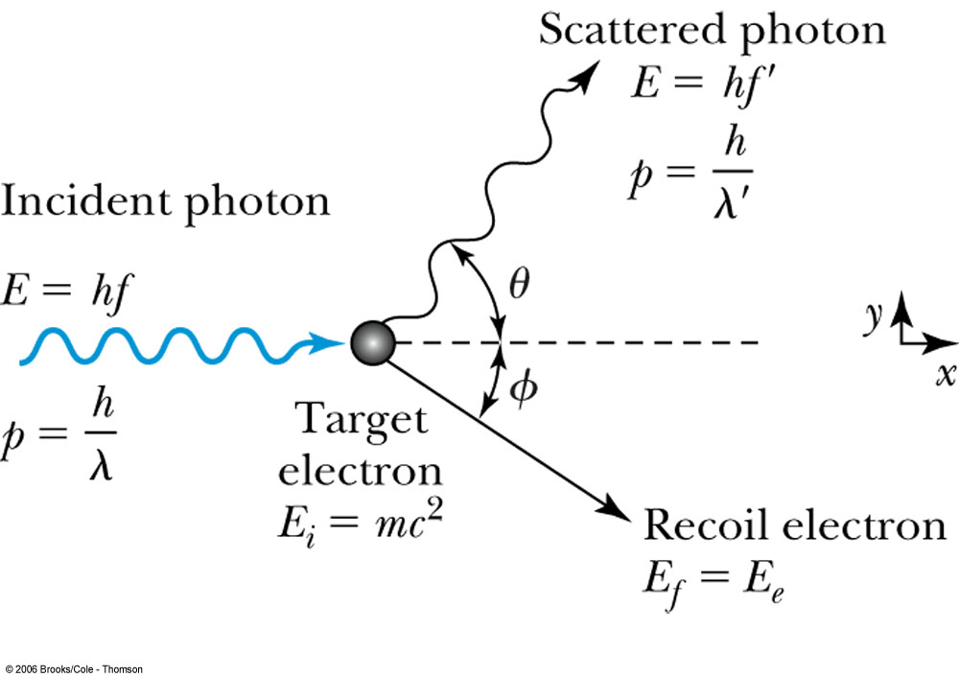
Before Collision
After Collision

Slide 65
Compton Scattering
In the Compton experiment, x rays are scattered from electrons. The scattered x rays have a longer wavelength than the incident x rays, and the scattered wavelength depends on the scattering angle ϕ.
Explanation: When an incident photon collides with an electron, it transfers some of its energy to the electron. The scattered photon has less energy and a longer wavelength than the incident photon.

Slide 66
Assumptions
Incident X-rays or EM radiations consists of photons of same energy.
Scattered electrons are assumed to be free particles.
The electrons of the scattering material are assumed to be at rest.
Collisions between incident X-ray photon and free electrons are perfectly elastic.

Slide 67
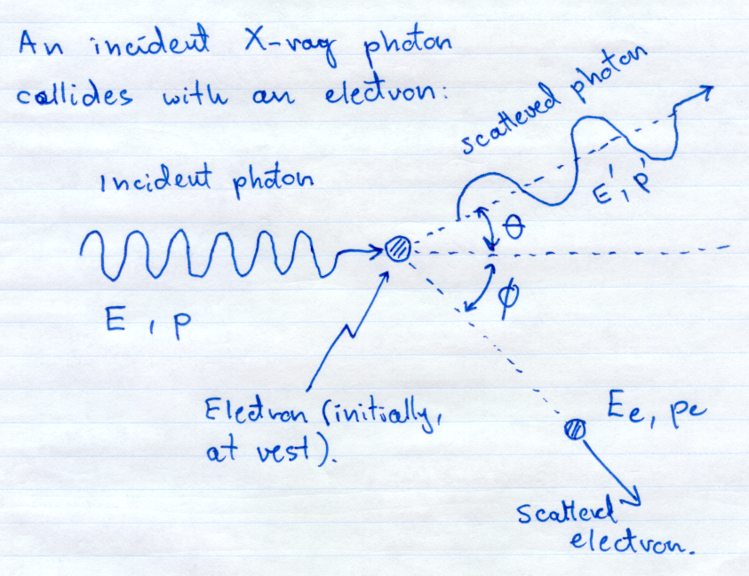

Slide 68
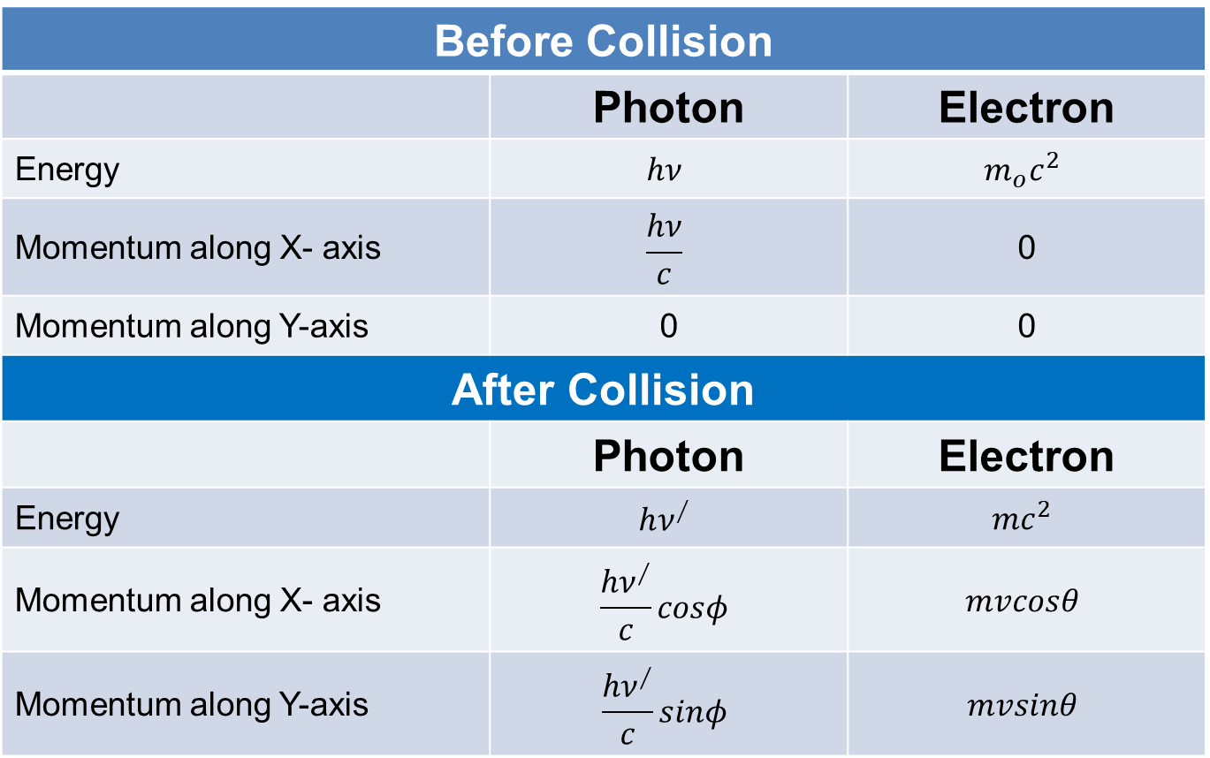
Before Collision
 | Photon | Electron
Energy | $$hν$$ | $$m_{o}c^{2}$$
Momentum along X- axis | $$\frac{hν}{c}$$ | 0
Momentum along Y-axis | 0 | 0
After Collision
 | Photon | Electron
Energy | $$hν^{∕}$$ | $$mc^{2}$$
Momentum along X- axis | $$\frac{hν^{∕}}{c}cosφ$$ | $$mvcosθ$$
Momentum along Y-axis | $$\frac{hν^{∕}}{c}sinφ$$ | $$mvsinθ$$

Slide 69
Energy Equation

Slide 70
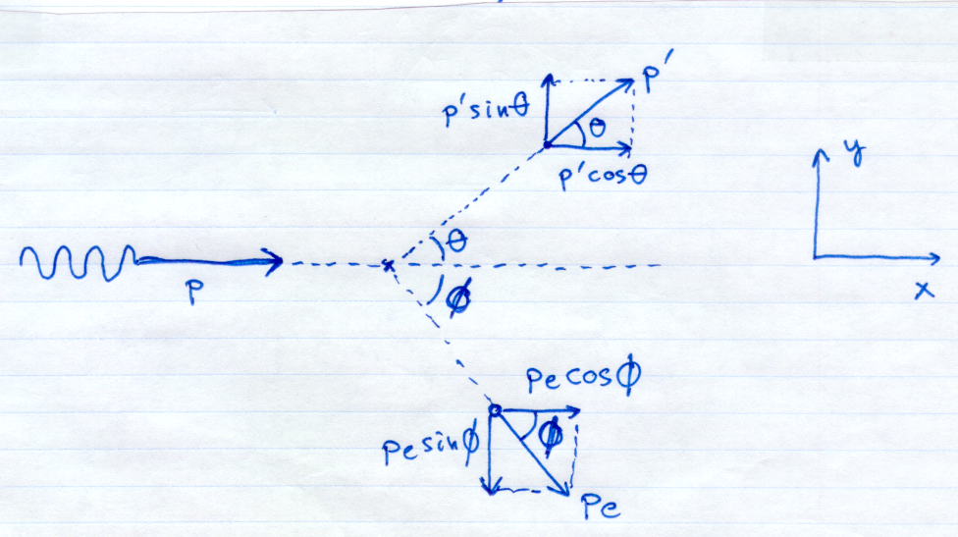
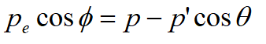
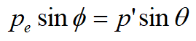
Momentum Equation
Momentum along x axis
Momentum along y axis

Slide 71
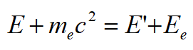
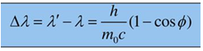
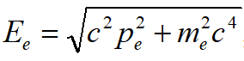
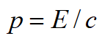
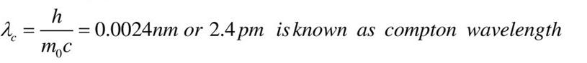
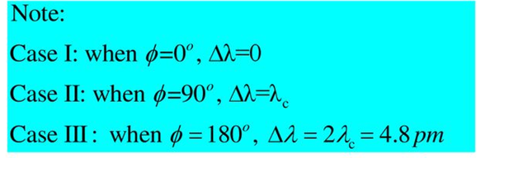
Solving Energy and Momentum Equations…

Slide 72
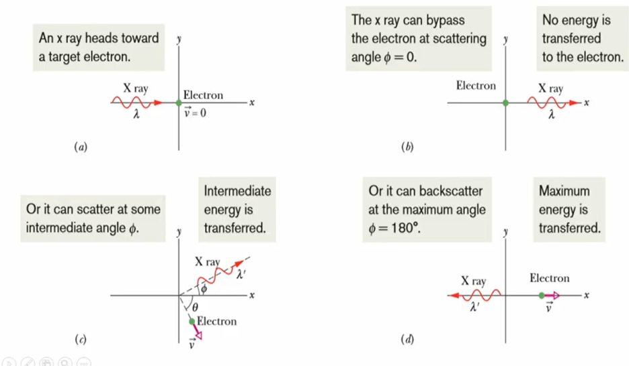

Slide 73
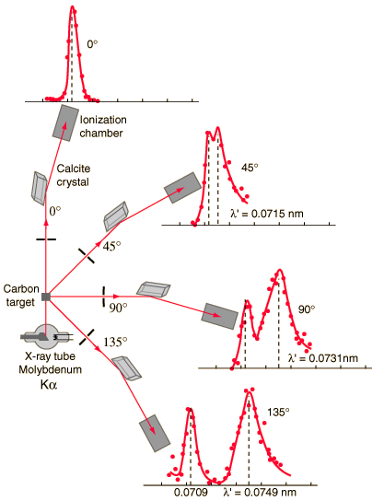

Slide 74
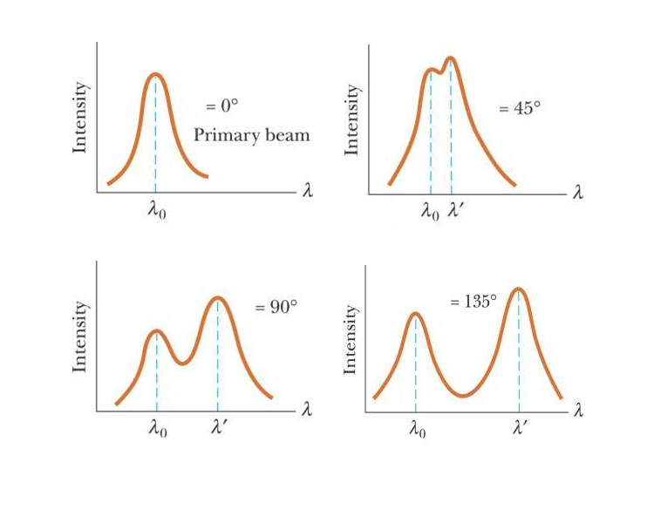

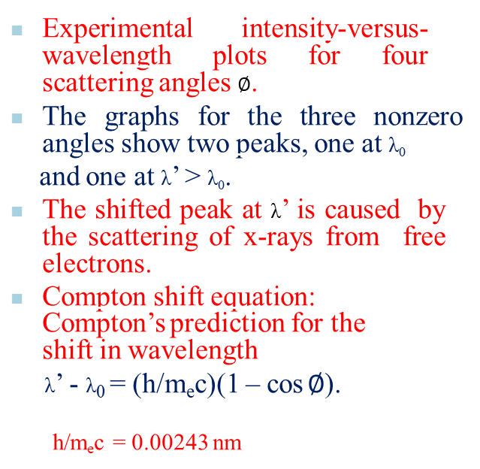
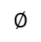
Compton Shift
Experimental intensity-versus- wavelength plots for four scattering angles $∅$.
The graphs for the three nonzero angles show two peaks, one at λ₀
and one at λ’ > λ₀.
The shifted peak at λ’ is caused by the scattering of x-rays from free electrons.
Compton shift equation: Compton’s prediction for the shift in wavelength
λ’ - λ₀ = (h/m_{e}c)(1 – cos $∅$).
h/m_{e}c = 0.00243 nm
$$∅$$
$$∅$$
$$∅$$
$$∅$$
Therefore scattering angle increases Compton shift increases

